Slide 1
Module 3
Asymmetric Encryption Algorithm and Key Exchange
Topic
Asymmetric key cryptographic techniques: principles, RSA

Slide 2
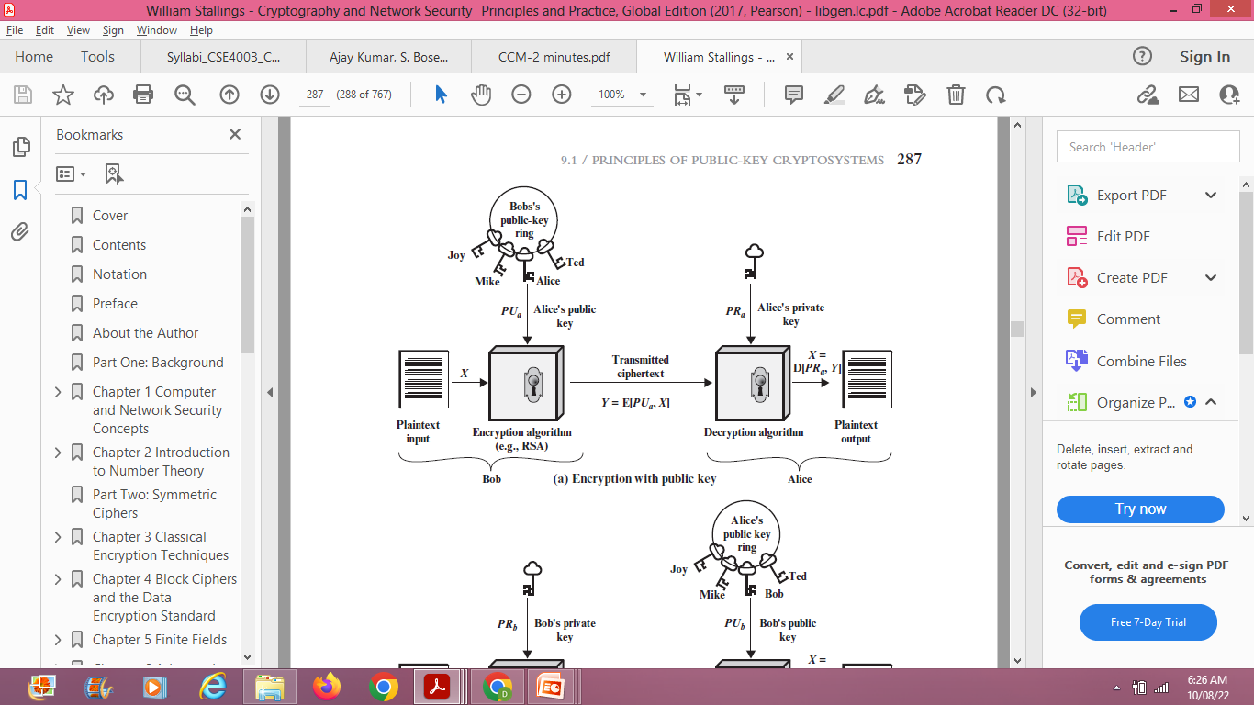
Public-Key Cryptosystems - Introduction

Slide 3
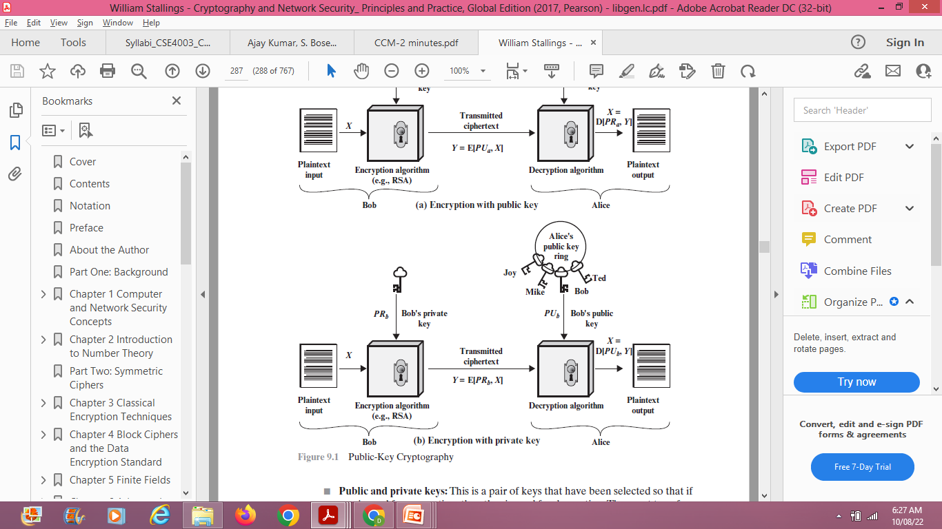

Slide 4
RSA Algorithm
One of the first successful responses to the challenge was developed in 1977 by Ron Rivest, Adi Shamir, and Len Adleman at MIT and first published in 1978
The Rivest-Shamir-Adleman (RSA) scheme – most widely accepted and implemented general-purpose approach to public-key encryption.

Slide 5
Steps of RSA
1. p, q are prime numbers
2. Calculate n = p * q
3. Calculate ø(n) = (p - 1) * (q - 1).
  The preceding relationship holds if e and d are multiplicative inverses modulo ø(n), where ø(n) is the Euler totient function
Select e such that e is relatively prime to ø(n) and less than ø(n);
GCD (ø(n), e) = 1
Find d (private key) such that de ≡ 1 mod ø(n) and d < ø(n)
  The relationship between e and d can be expressed as
  ed mod ø(n) =1
  ed ≡ 1 mod ø(n)
  d ≡ e-1 mod ø(n)

Slide 6
  To encrypt, find ciphertext C = Me mod n
    Public key encryption algorithm with a public key of PU = {e, n}
  7. To decrypt, find plaintext M = C^{d} mod n
private key of PR = {d, n}.

Slide 7
Example 1
Inputs are p = 17, q = 11 and M = 88
Two prime numbers such as p = 17, q=11
Calculate n = p * q
n = 17 * 11
n = 187
Calculate ø(n) = (p - 1) * (q - 1)
= (17 – 1) * (11 – 1)
= 16 * 10
ø(n) = 160
Select e such that e is relatively prime to ø(n) = 160 and less than ø(n); we choose e = 7.
GCD (ø(n), e) = 1
GCD (160, 7) = 1 ------ Possible values are, 3, 7, 11,…..

Slide 8
Find d (private key) such that de ≡ 1 mod ø(n) and d < ø(n)
d ≡ e⁻¹ mod ø(n)
d ≡ 7⁻¹ mod 160
7 x ? mod 160 = 1
7 x 23 mod 160 = 1
161 mod 160 = 1
d = 23
de ≡ 1 mod ø(n)
23 x 7 ≡ 1 mod 160
161 ≡ 1 mod 160
161 mod 160 = 1 mod 160
1 = 1

Slide 9

Alternate Method _ Finding d value using EEA
q | a | b | r | t1 | t2 | t
22 | 160 | 7 | 6 | 0 | 1 | -22
1 | 7 | 6 | 1 | 1 | -22 | 23
6 | 6 | 1 | 0

Slide 10
Cont…
5. To do encryption
  C = Me mod n PU = (e, n) = (7, 187) M = 88
  C = 88⁷ mod 187,
88⁷ mod 187 = [(88⁴ mod 187) * (88² mod 187)
* (88¹ mod 187)] mod 187
88¹ mod 187 = 88
88² mod 187 = 7744 mod 187 = 77
88⁴ mod 187 = (88²)² mod 187
= 77² mod 187 = 5929 mod 187 = 132
88⁷ mod 187 = (132 * 77 * 88) mod 187
= 894,432 mod 187
C = 11

Slide 11
Cont…
  6. To do Decryption
  M = C^{d} mod n PR = (d, n) = (23, 187) C = 11
  M = 11²³ mod 187
11²³ mod 187 = [(11¹ mod 187) * (11² mod 187) *
(11⁴ mod 187) * (11⁸ mod 187) * (11⁸ mod 187)] mod 187
11¹ mod 187 = 11
11² mod 187 = 121
11⁴ mod 187 = 121² = 14,641 mod 187 = 55
11⁸ mod 187 = 55² = 3025 mod 187 = 33
11²³ mod 187 = (11 * 121 * 55 * 33 * 33) mod 187
M = 79,720,245 mod 187
M = 88

Slide 12
Example 2
Inputs are p = 3, q = 5, e (public key) = 3 and m=2
Two prime numbers such as p = 3, q=5
Let n= p * q
n = 3 * 5
n = 15
Let ø(n) = (p-1)*(q-1).
= (3 – 1) * (5 – 1)
ø(n) = 8

Slide 13
Cont…
Find d (private key) such that de =1 mod ø(n)
d = e⁻¹ mod ø(n)
d = 3⁻¹ mod 8
3 x d mod 8 = 1
3 x 3 mod 8 = 1
9 mod 8 = 1
d = 3

Slide 14
Cont…
5. To do encryption
  C = Me mod n
  C = 2³ mod 15, C = 8 mod 15, C = 8
  6. To do Decryption
  m = C^{d} mod n
  m = 8³ mod 15, m = 512 mod 15, m = 2

